Slide 1
Online Shopping Mall
P2010411 Grant Jing
P2010556 Polo Liu
P2010562 Veronica Chen

Slide 2
Outline
} Business Model
Seller Center
Customer Q&A
Sidebar Shopping Cart
Shopping Festival
Coupons
}
User-friendly Design
}
Marketing

Slide 3
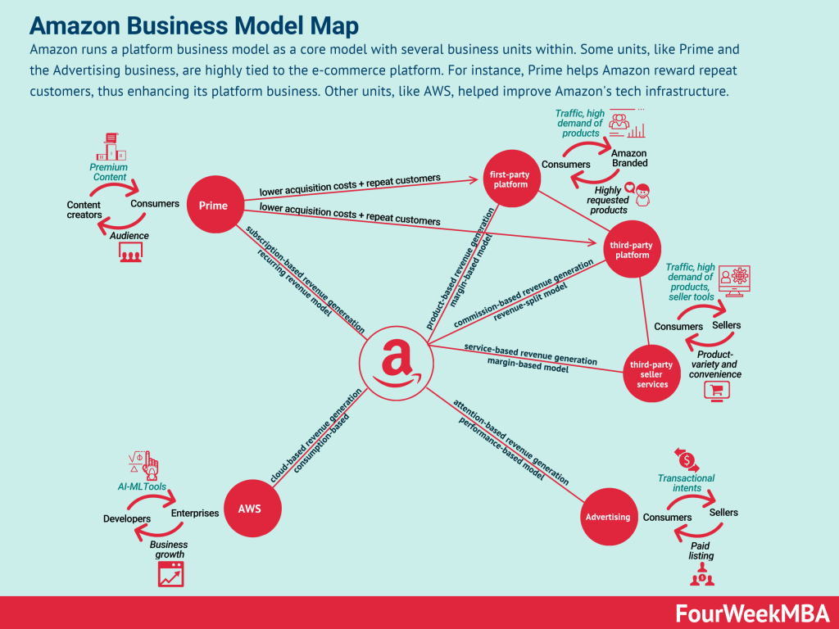
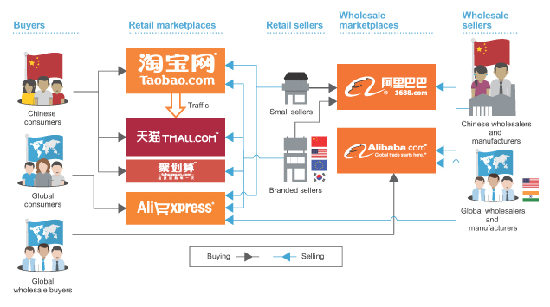
Business Model
Alibaba Business Model
B2C (Business to Customer)
+
C2C (Customer to Customer)
↓
Hybrid

Slide 4
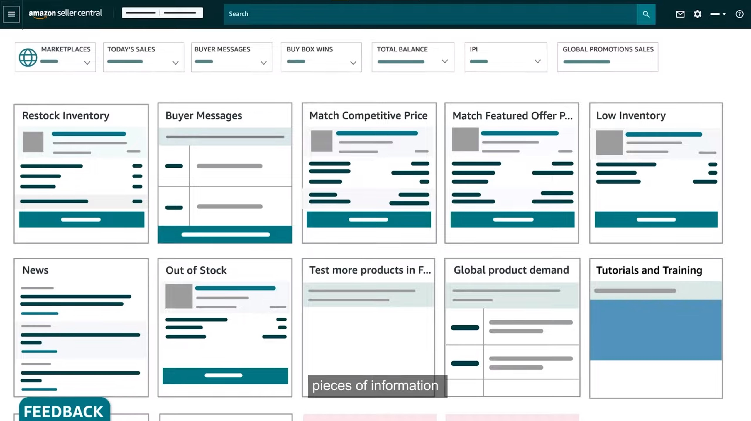
Business Model (Seller Center)
Provide a user-friendly interface especially for sellers in C2C business model
The Seller Center of Amazon

Slide 5


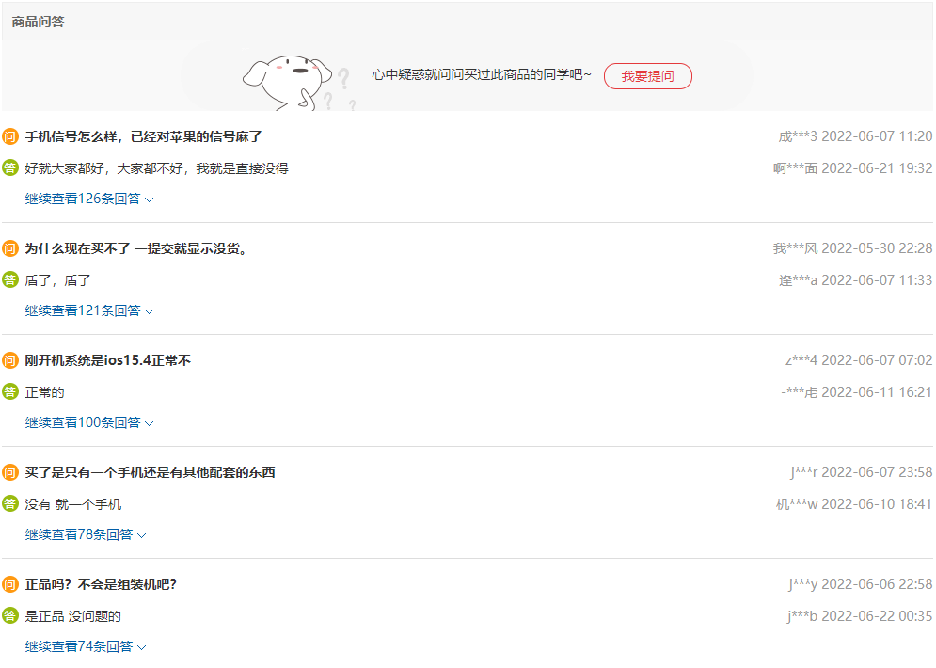
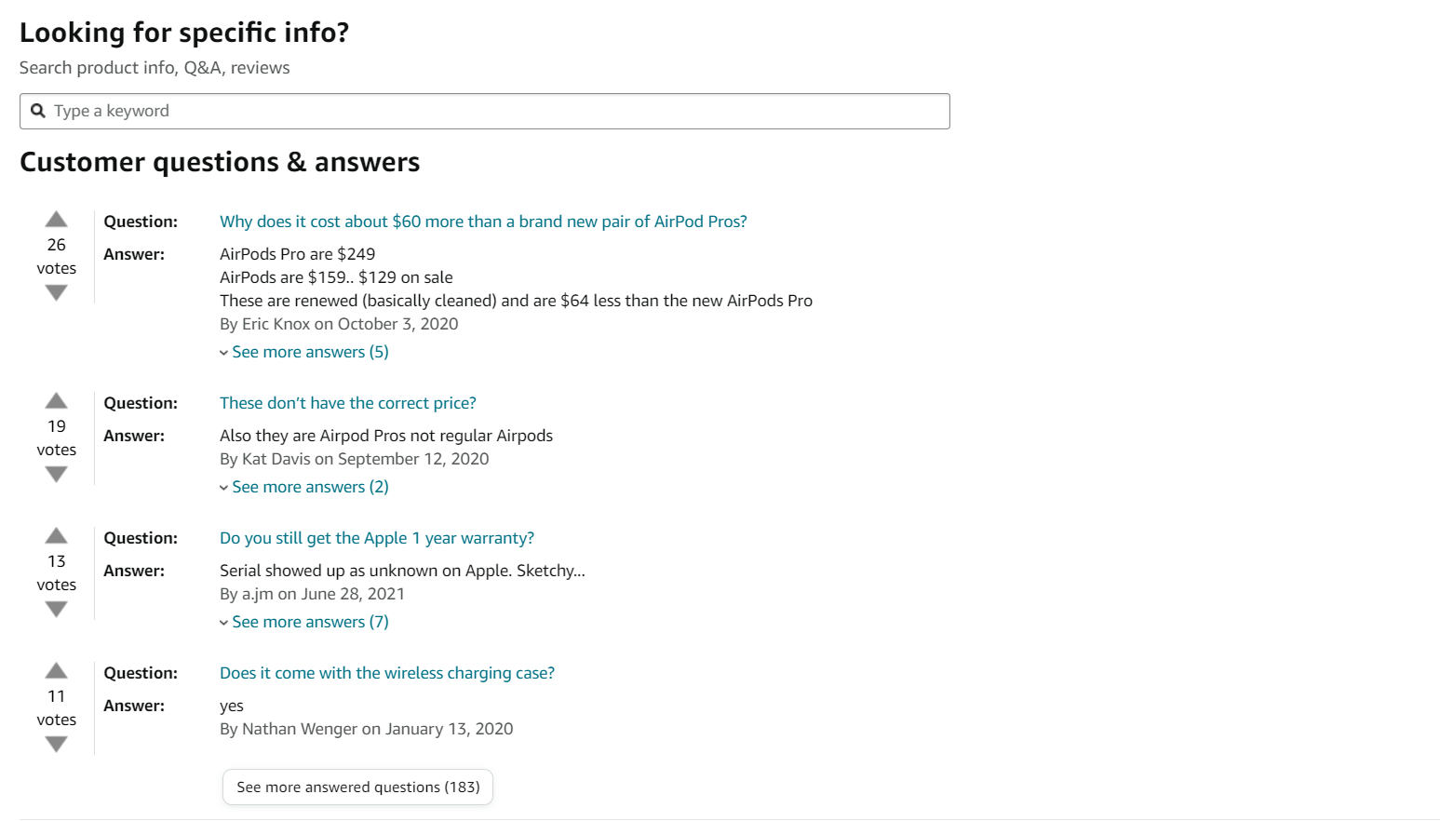
User-friendly Design (Customer Q&A)

Slide 6
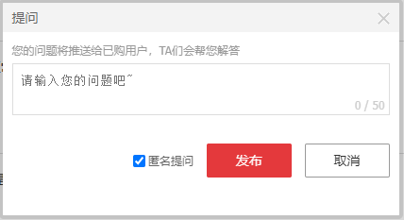
User-friendly Design (Customer Q&A)
The Customer Q&A of JD.com

Slide 7
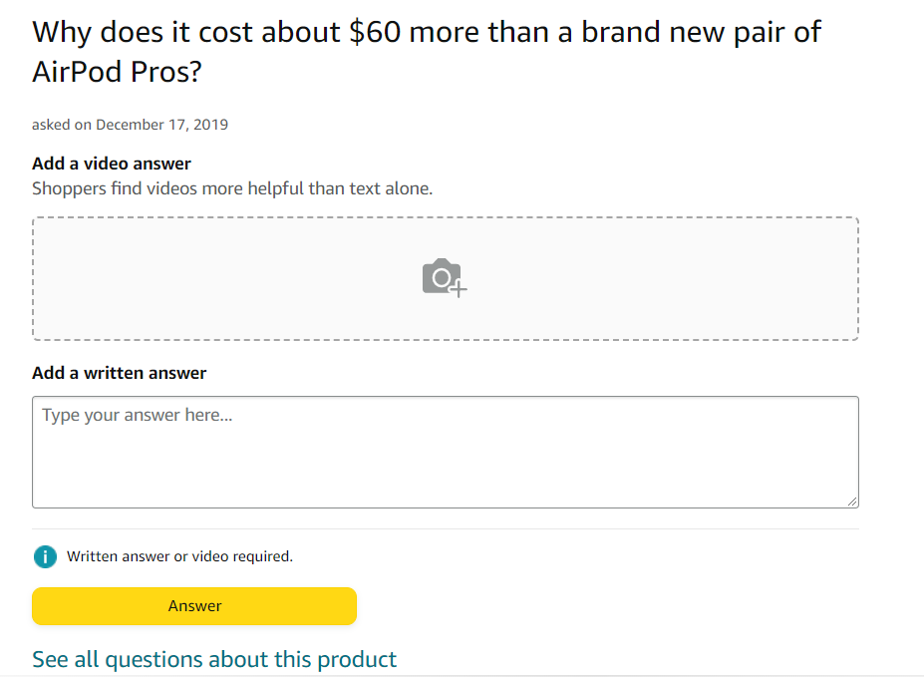
User-friendly Design (Customer Q&A)
The Customer Q&A of Amazon

Slide 8



User-friendly Design (Sidebar Shopping Cart)

Slide 9
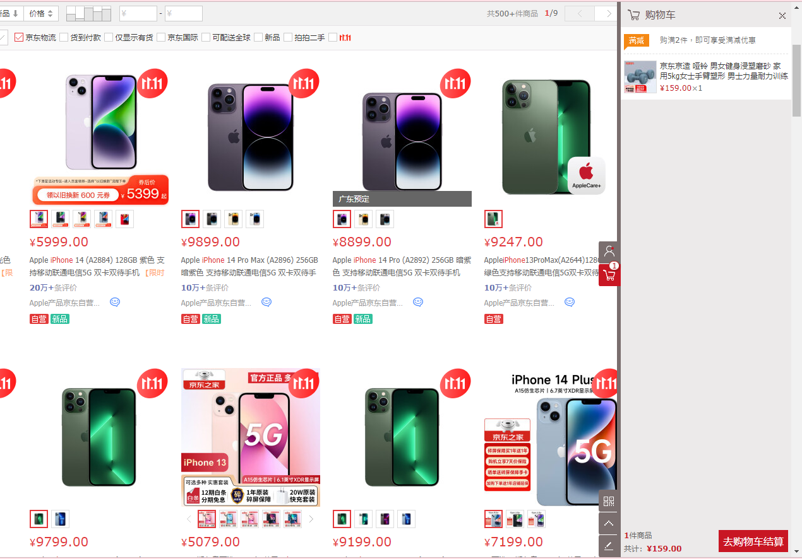
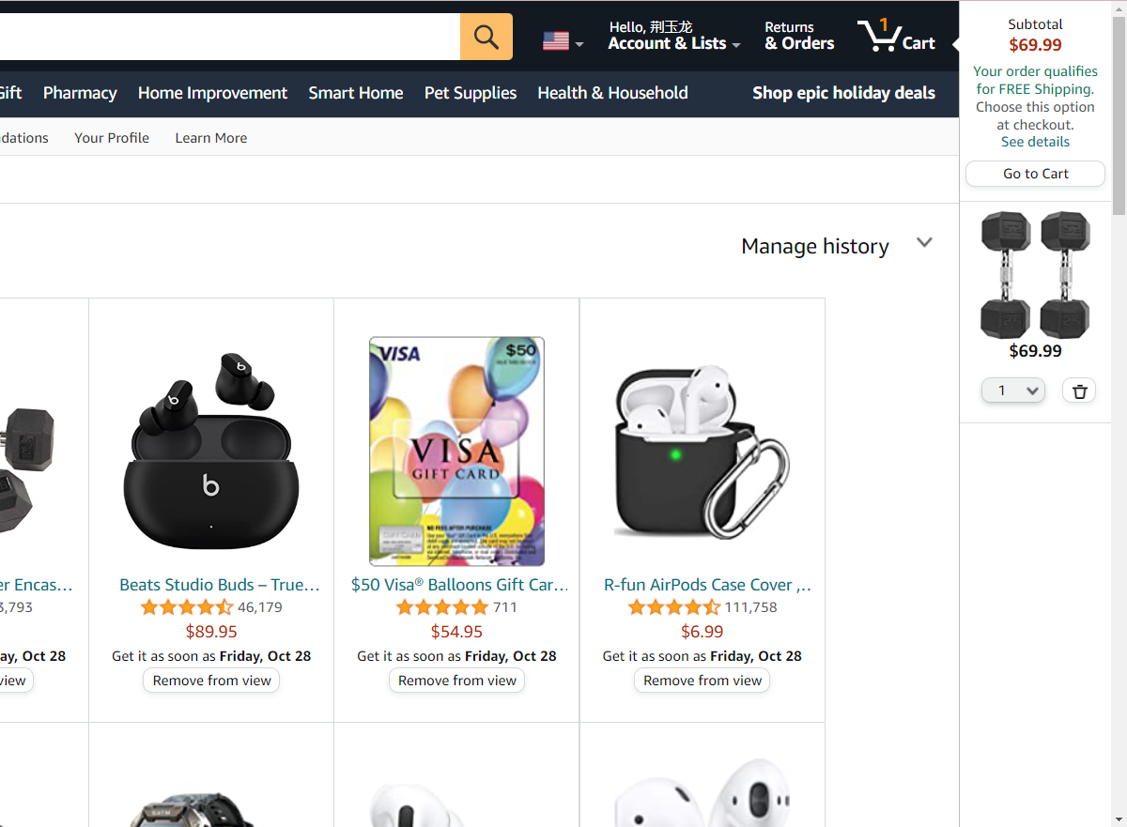
User-friendly Design (Sidebar Shopping Cart)
The sidebar shopping cart of JD.com
The sidebar shopping cart of Amazon

Slide 10
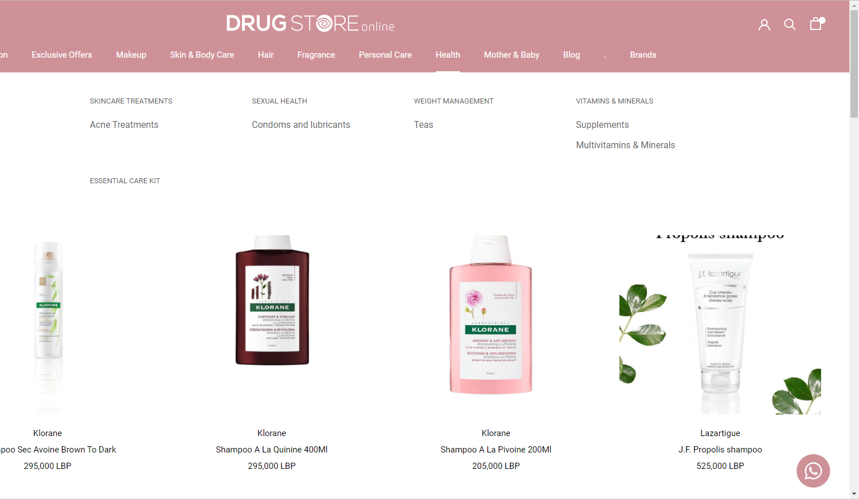
User-friendly Design (Sidebar Shopping Cart)
This drug website doesn't have the sidebar shopping cart.

Slide 11


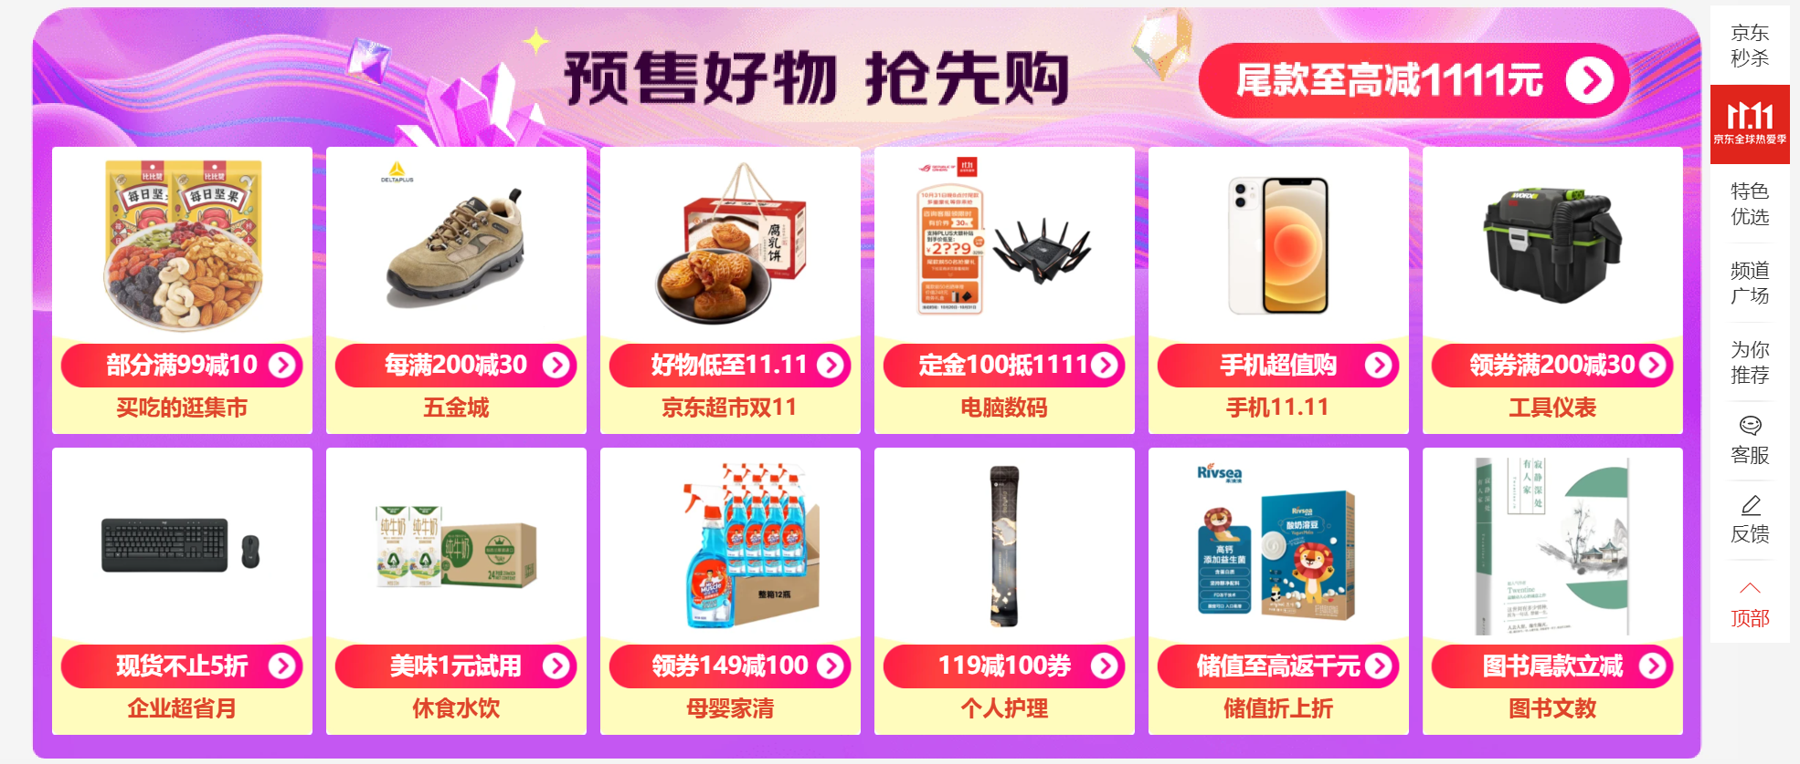
Marketing (Shopping Festivals)

Slide 12
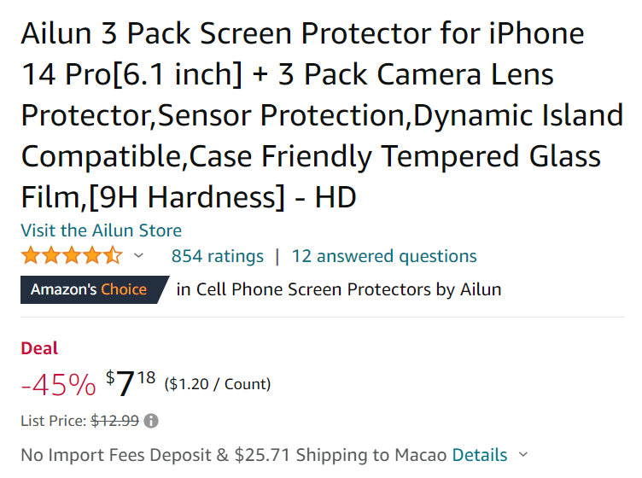

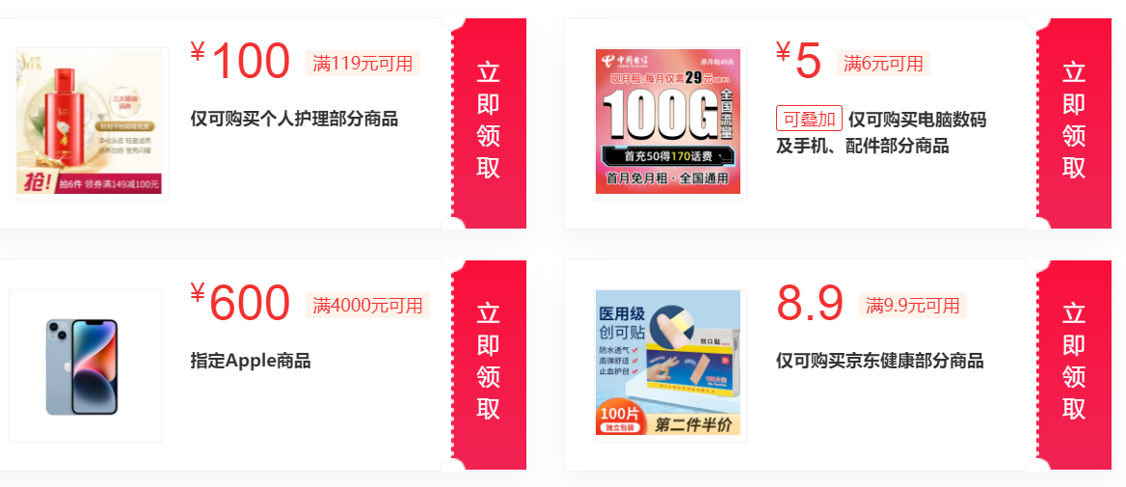
Marketing (Coupons)

Slide 13
Conclusion

Slide 14

Q & A

